Slide 1
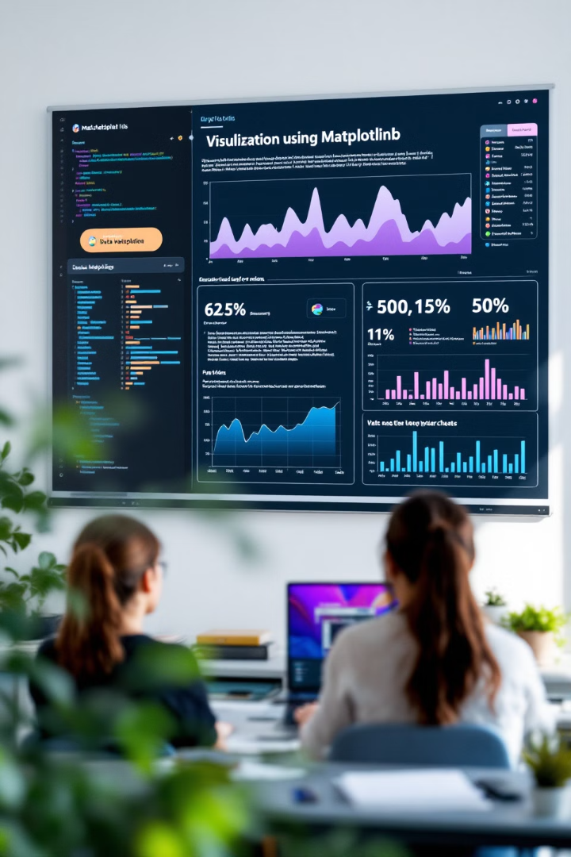

Python Data Visualization with Matplotlib
Welcome to our exploration of data visualization in Python. This presentation will guide beginners through using Matplotlib to transform abstract data into meaningful visuals.
by EMRE Akpınar

Slide 2

What is Data Visualization?
Making Data Concrete
Finding Patterns
Communicating Insights
Visualization converts abstract numbers into tangible, interpretable forms. Complex patterns become visible at a glance.
Visuals reveal relationships between data points that might be invisible in spreadsheets. Outliers stand out immediately.
Charts and graphs help share discoveries with others. They support better decision-making across teams.

Slide 3

Getting Started with Matplotlib
Installation
Use Python's package manager to install Matplotlib. Type 'pip install matplotlib' in your terminal.
Importing
Add Matplotlib to your project with 'import matplotlib.pyplot as plt'. This creates the standard alias.
Loading Data
Prepare data for visualization. Pandas works well for reading CSV files into dataframes.

Slide 4




Creating Your First Plot
Set Figure Size
Start with plt.figure(figsize=(12, 6)) to define your canvas dimensions.
Define the Plot
Use plt.plot(x_data, y_data) to specify what data to display.
Show the Result
Call plt.show() to display your visualization.

Slide 5
Enhancing Your Visualizations
Add Labels
Include a Title
Customize Colors
Use plt.xlabel() and plt.ylabel() to name your axes. This helps viewers understand the data context.
Add plt.title() to provide a clear description of what the chart represents.
Specify colors in your plot commands to make data series distinct and visually appealing.

Slide 6
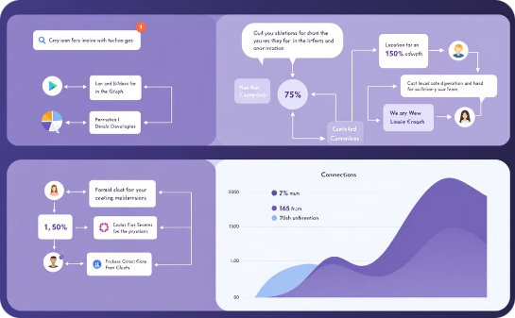
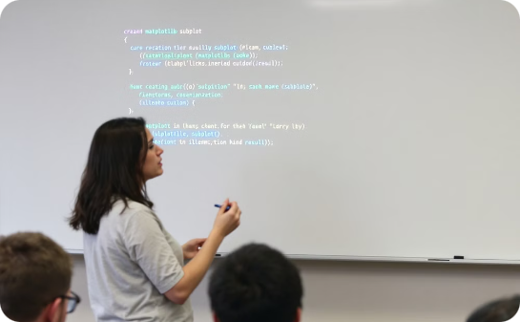

Working with Multiple Plots
Side-by-Side Comparison
Subplot Syntax
Analytical Power
Use plt.subplots(rows, columns) to create a grid of charts. This allows direct comparison of different data relationships.
The code fig, axes = plt.subplots(1, 2) creates one row with two columns of plots. Access each with axes[index].
Multiple plots enable comprehensive data analysis. Different angles reveal deeper insights.

Slide 7

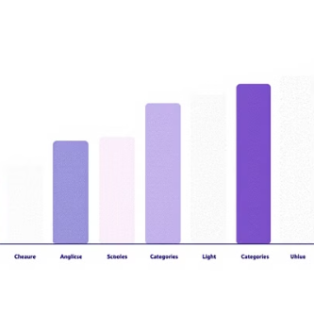
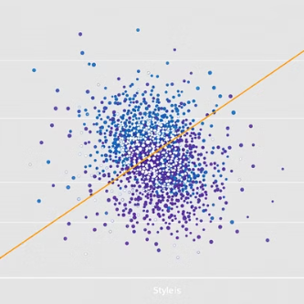

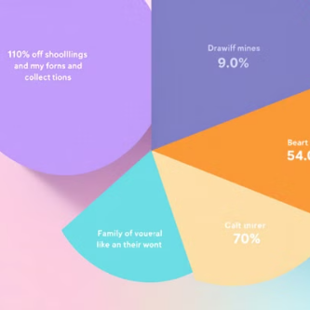
Chart Types in Matplotlib
Matplotlib supports diverse chart types for different analytical needs. Choose the right visualization based on what story your data tells.

Slide 8
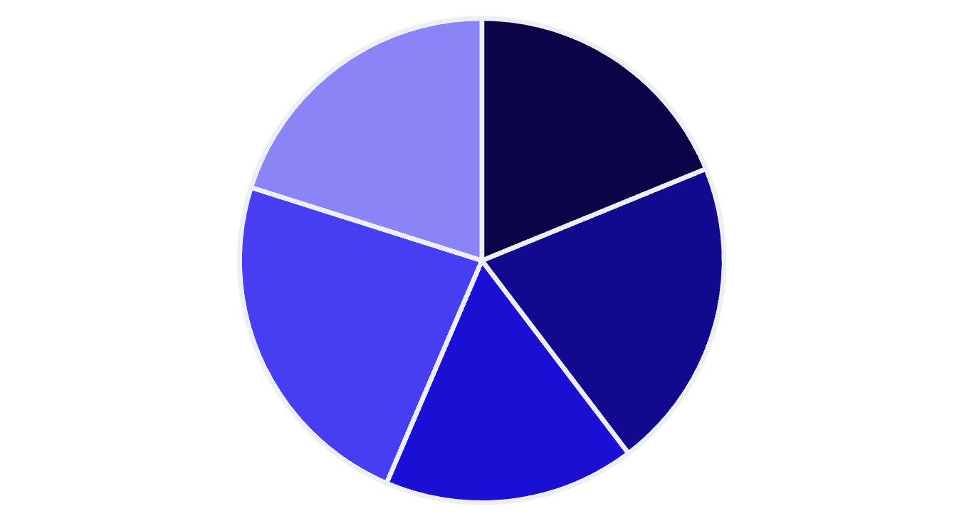
Practical Example: Salary Analysis
John
Maria
Carlos
Anna
Jamal
This pie chart uses plt.pie(df["Salary"], labels=df["Name"]) to show salary distribution. Each segment represents an employee's proportion of total compensation.

Slide 9

Next Steps in Your Data Visualization Journey
Master Basic Charts
1
Practice creating and customizing the fundamental chart types. Experiment with different datasets.
2
Learn Advanced Customization
Explore color maps, styling, and annotations. Make your visualizations more professional.
Combine with Image Processing
3
Apply visualization techniques to image analysis. Extract and plot data from visual sources.
4
Create Interactive Visuals
Experiment with matplotlib extensions that support interaction. Enable users to explore data directly.

